Slide 1
Anti-theft System
Group Wolf

Slide 2
Outline
Problem Statement
Introduction
Approach
Use cases
Object Model
Screen shot
Demo

Slide 3
Problem Statement
Nowadays, the safe of citizen’s property face more threats from thefts. More and more related crimes happen. Citizen look forward for an easy-using and reliable way to keep their property safe.
For example, it is said that many Canada Goose were stolen last year in Boston University.

Slide 4
Introduction
Real-time interaction between the equipment and secure company.
A highly intelligent App that easy for customers and employee to use.
App to ensures the safety of customer’s personal property.
Eco-system structure.

Slide 5

Approach
Eco-system structure.
If an alert is triggered by the anti-theft equipment, an request is sent to Secure first.
Secure officer reports crime to police station.
If the customer’s personal property has been damaged, Secure officer will send an alert to Insurance.

Slide 6
Object Model

Slide 7
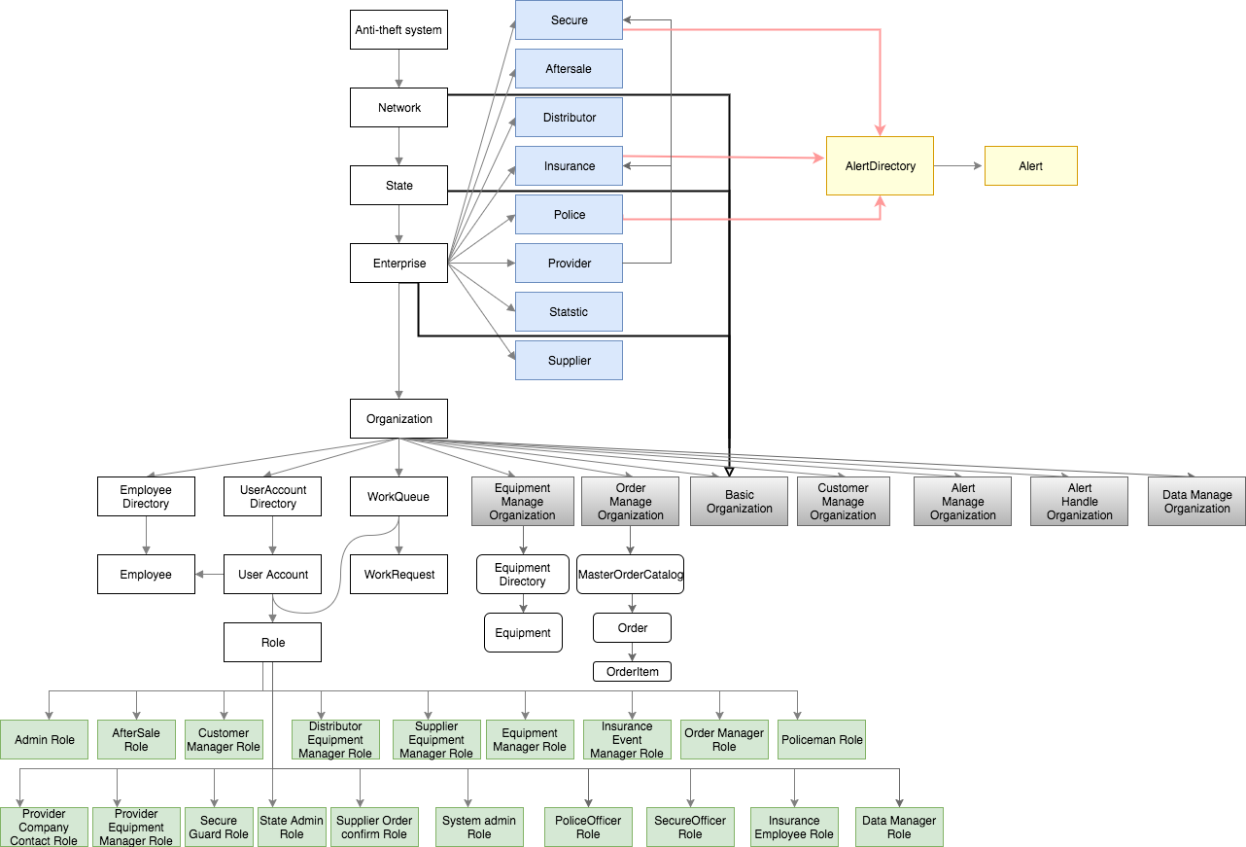
Object Model

Slide 8
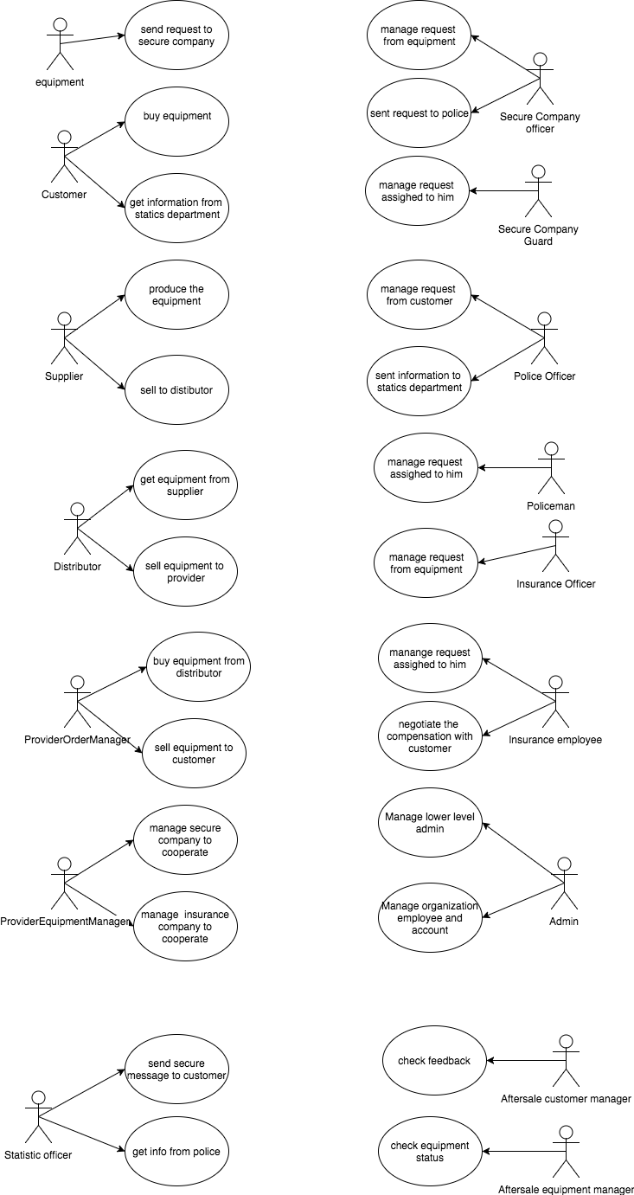
Use cases

Slide 9
Special Features
Welcome E-mail
Google Map
Real-Time detection
Data Statistic

Slide 10
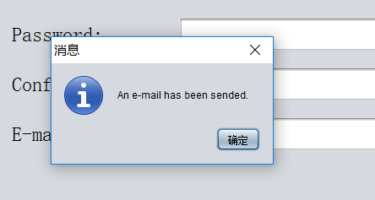
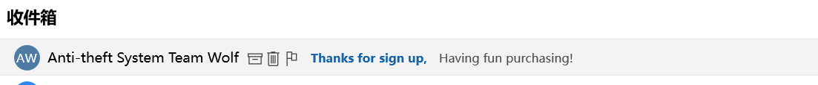
Welcome E-mail
In order to show our greetings to the customer, the system is able to send an welcome e-mail to the customer when he signs up.

Slide 11
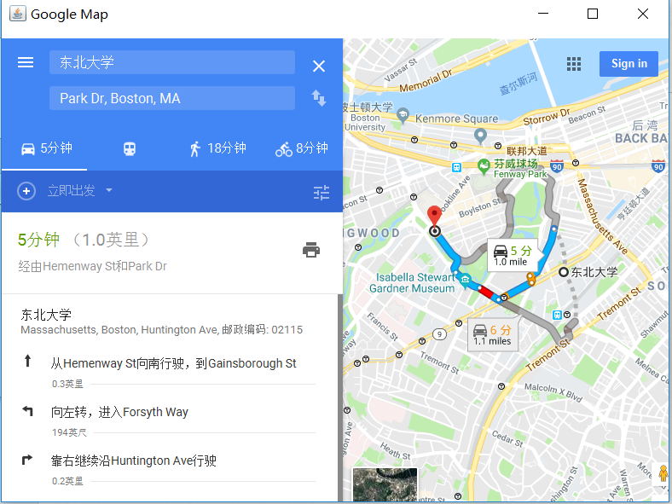
Google Map
In order to help the employee to find the place, we embed a function which allows google map service.

Slide 12
Real-time detect
Our system do the detection based on the real-time situation. The equipment detect alert event every five seconds. And it send its own status to the aftermarket department.
This function is based on java multithreading.

Slide 13
Data Statistic

Slide 14
Screenshots

Slide 15
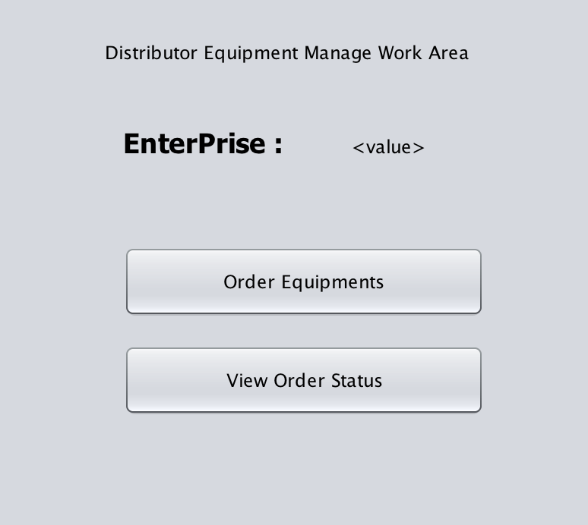
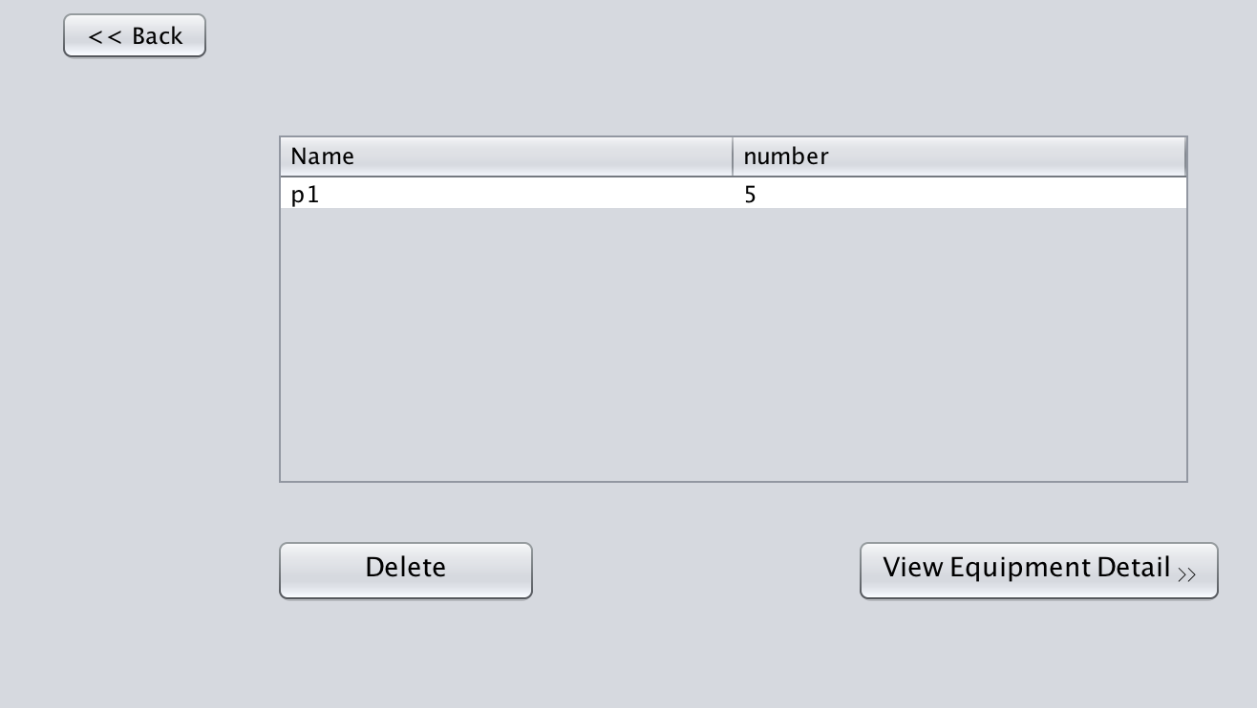
Distributor
Equipment Manage Organization
Order Manage Organization

Slide 16
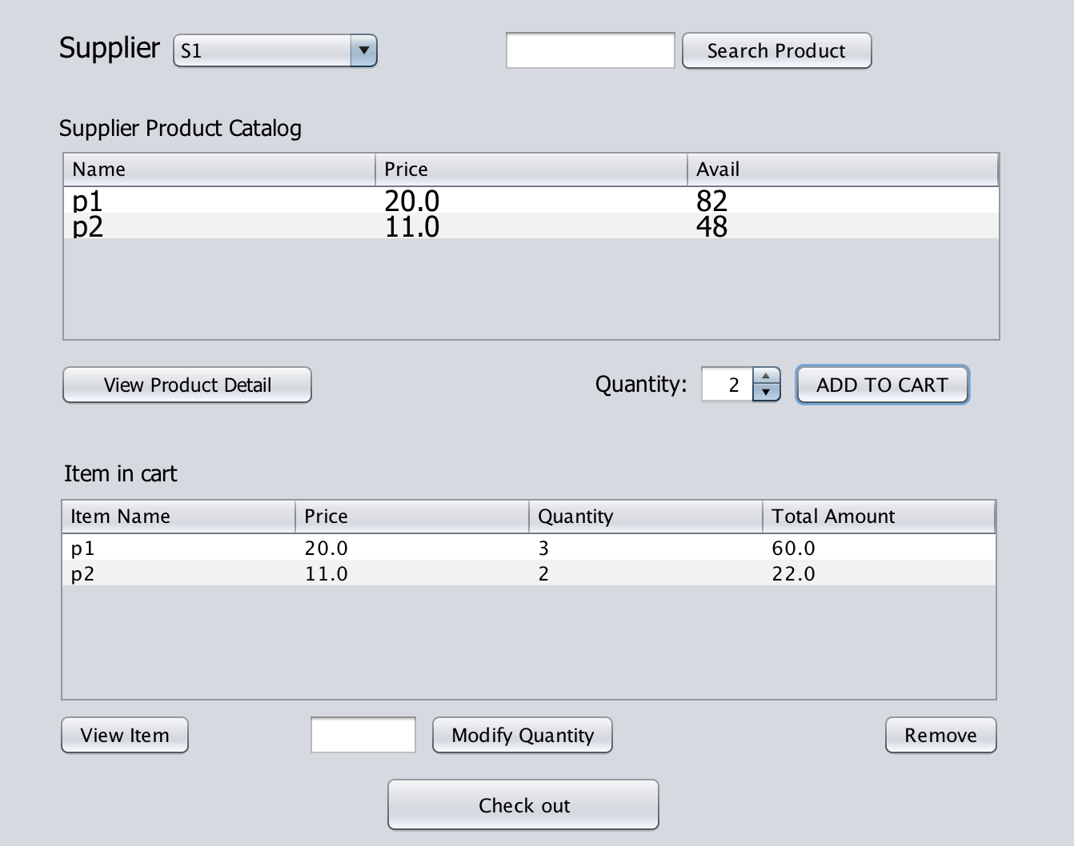
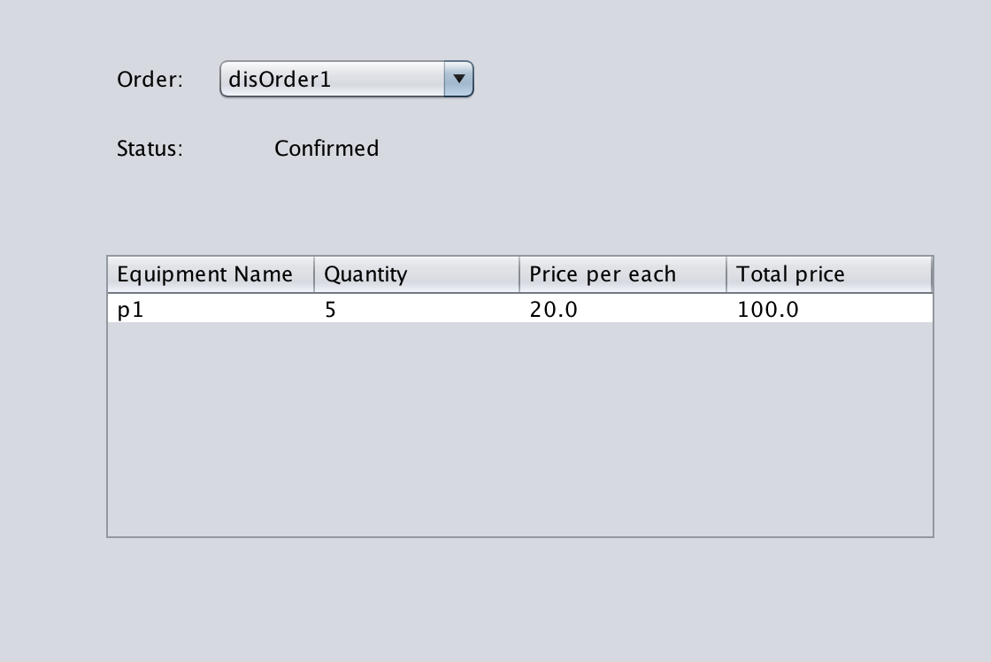
Distributor
Order Manage Organization
order equipments from suppliers
check the order status

Slide 17
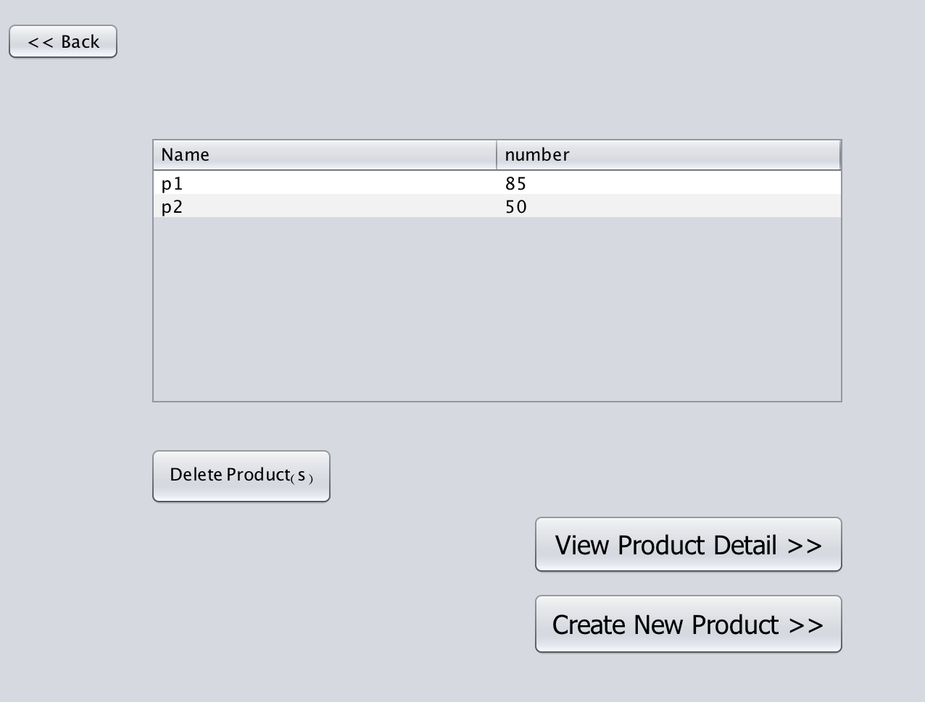
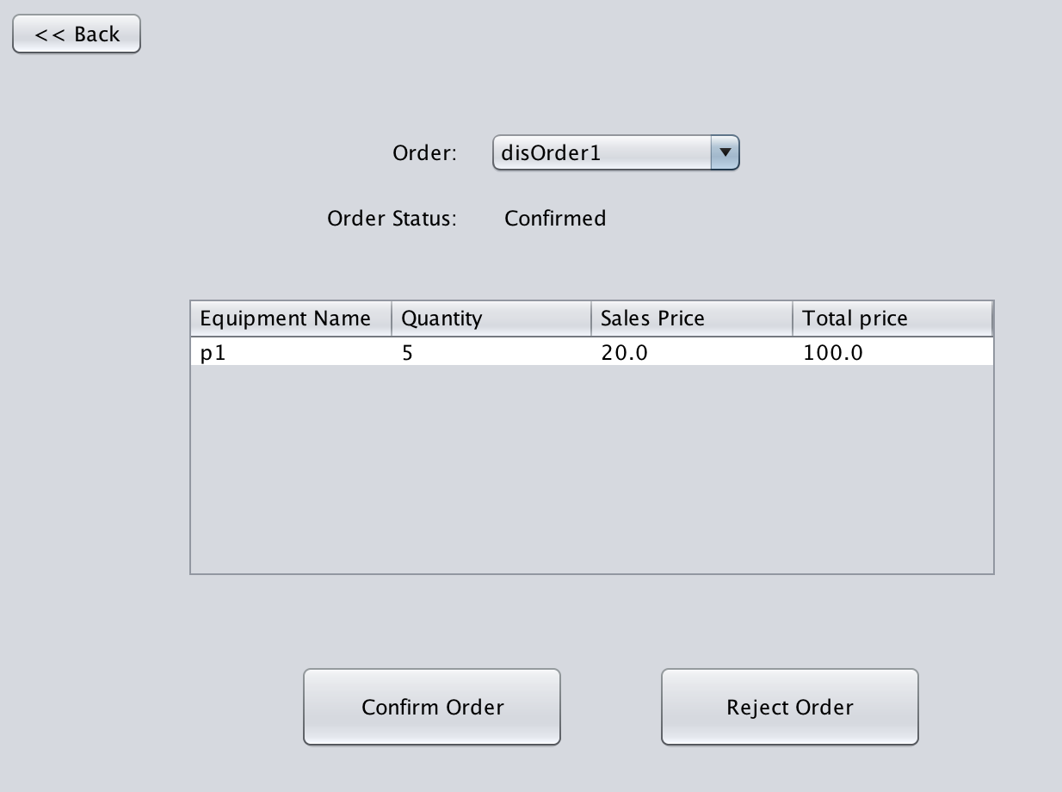
Supplier
Equipment Manage Organization
Order Manage Organization

Slide 18
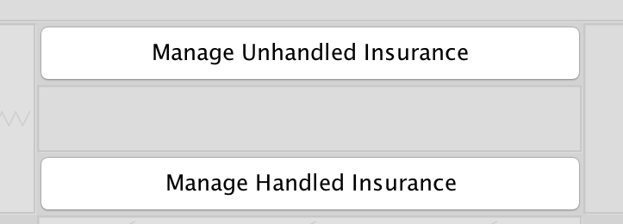
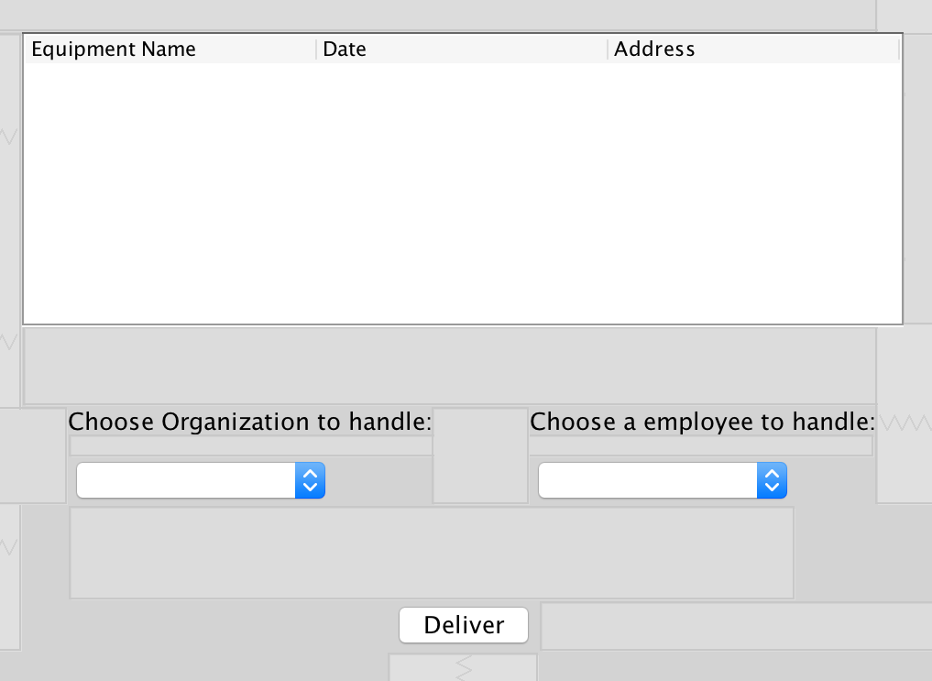
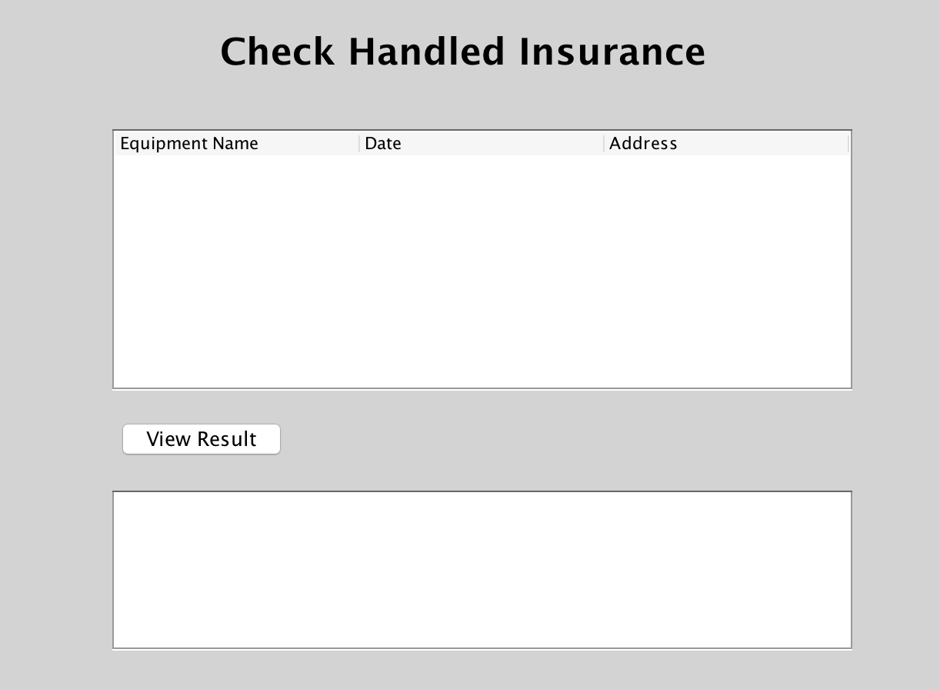

Insurance/Secure/Police Officer

Slide 19

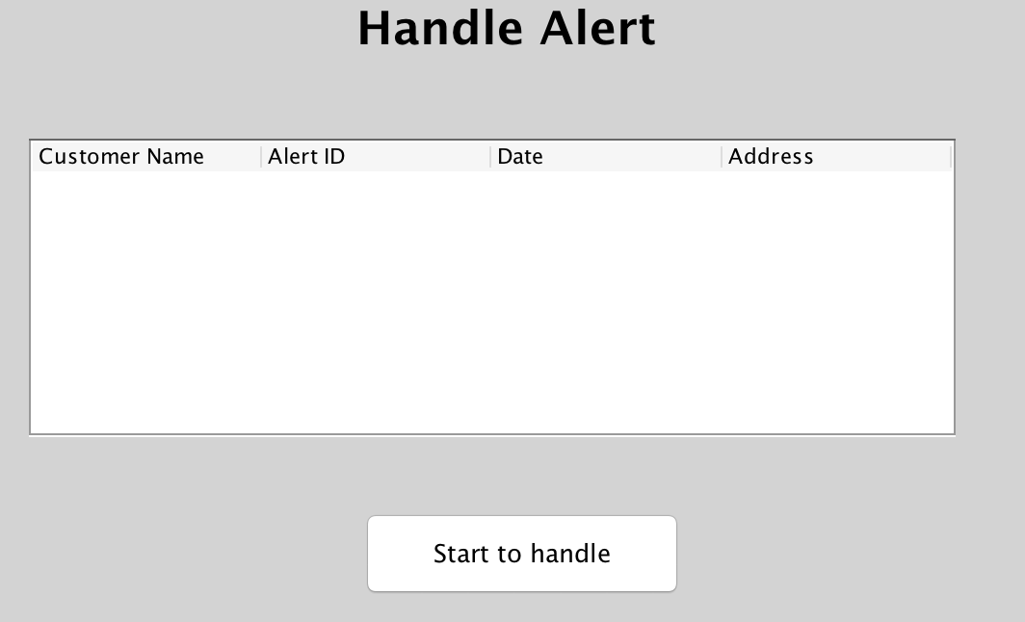
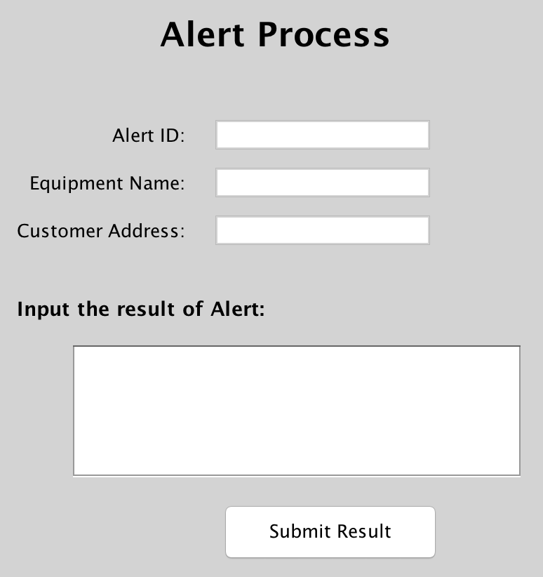
Insurance/Secure/Police Employee

Slide 20
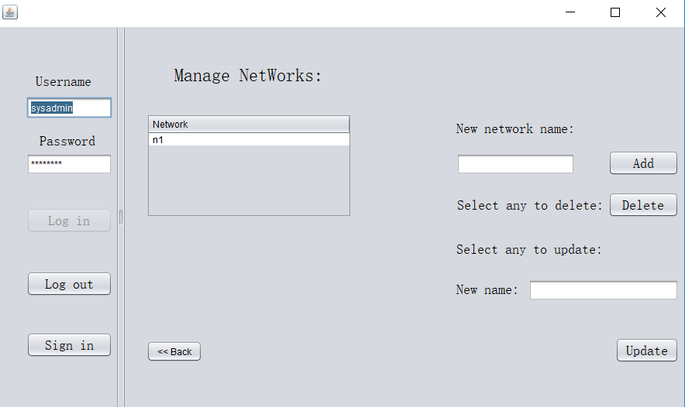
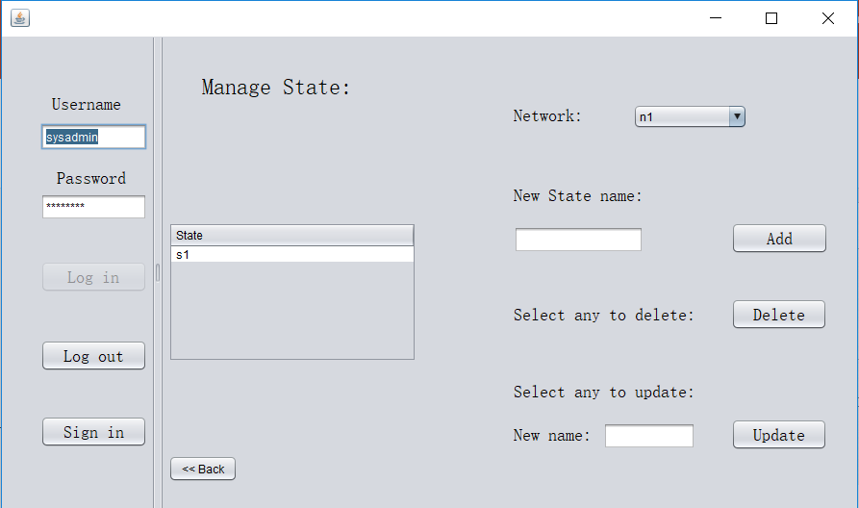
System Admin
Manage Network
Manage State

Slide 21
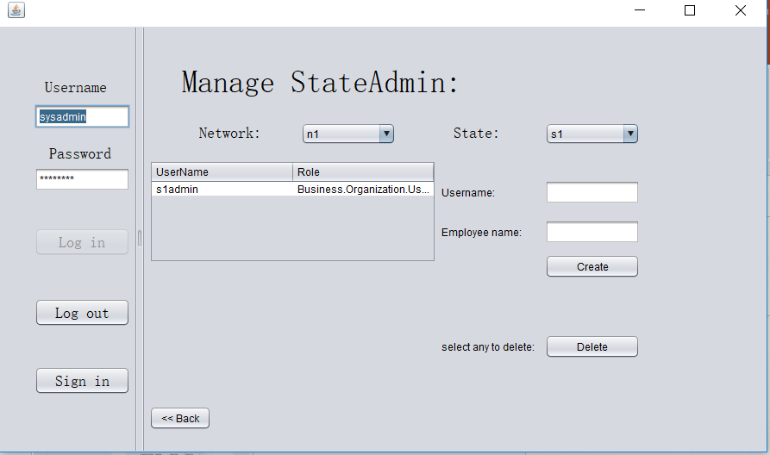
System Admin
Manage State admin accounts

Slide 22
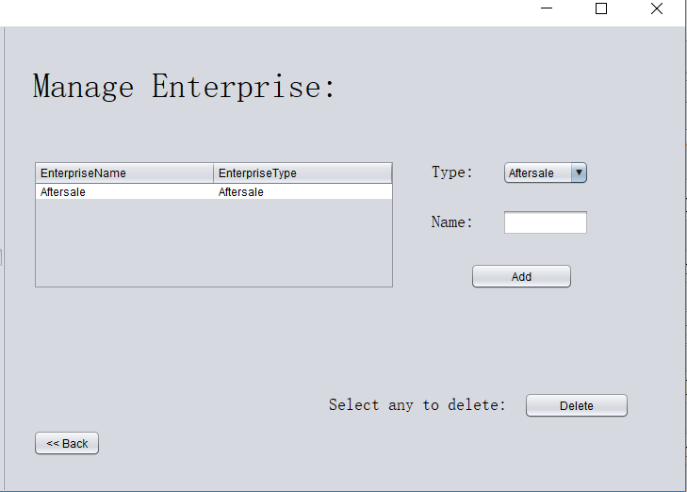
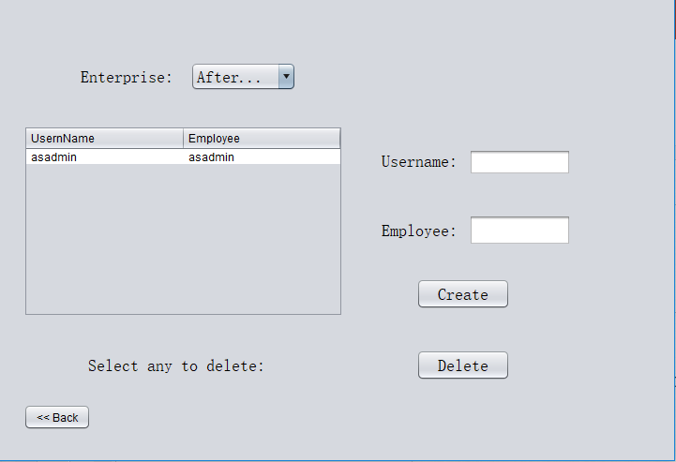
State Admin
Manage Enterprise
Manage Enterprise Admin Accounts

Slide 23
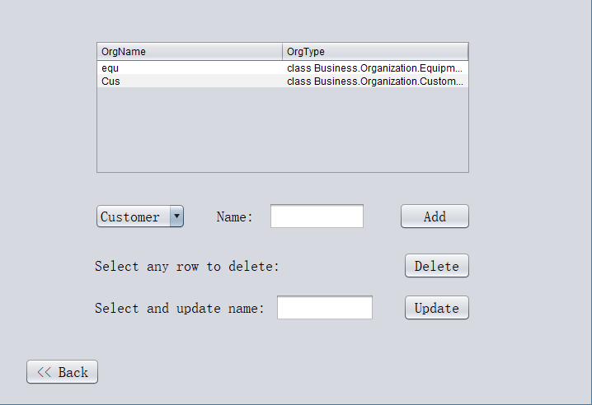
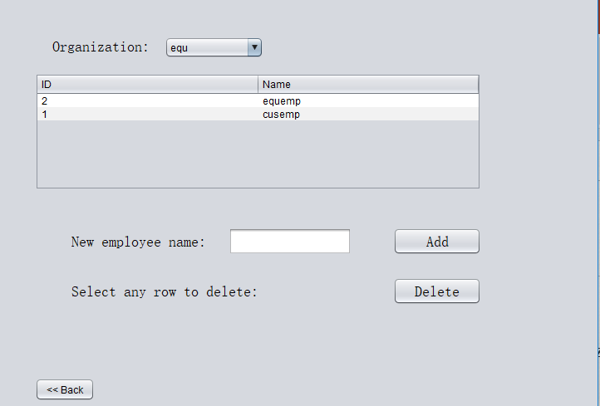
Enterprise Admin
Manage Organization
Manage Employee

Slide 24
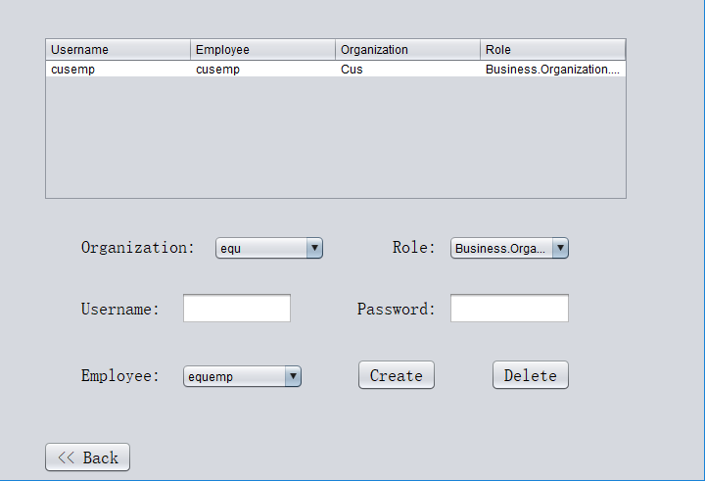
Enterprise Admin
Manage Accounts

Slide 25
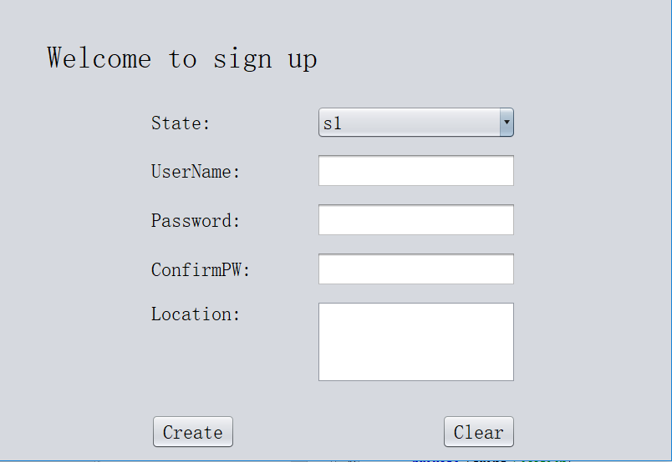
Customer
Sign up

Slide 26
Demo

Slide 27
Thank you
–wolf

